Slide 1
Indicator Frameworks
Joshua Tan (University of Oxford), Christine Kendrick (City of Portland), Abhishek Dubey (Vanderbilt University), and Sokwoo Rhee (NIST)
GCTC Expo
August 29, 2017
Notes:
It’s kind of a foundational talk. The point of this workshop is to help you think about data, and about ‘indicators’, in a slightly different way that you usually do.

Slide 2
Start with the data you have, not the data you want.

Slide 3
Why indicator frameworks?
Sets the strategic priorities of your project, department, or city
Communicate progress to stakeholders
Enable policy reactions to data, especially in the optimization of processes
Simplify your situation
Notes:
How many people build dashboards?
Why do you think Tableau exists?

Slide 4
How do we usually build indicators?
Notes:
It’s basically the same as building a standard. The point is, it’s expensive, it’s time-consuming, it’s expert-driven, and the results don’t always line up in a way that lets you get easy comparisons. We need a SYSTEMIZATION.

Slide 5
Indicator: “Access to public amenities”
Description: It is presumed that nearby availability of amenities leads to a lively neighbourhood and less car use. Amenities in the urban environment make an area more enjoyable and contribute to its desirability. It is assumed that these factors contribute to the success of smart city projects.
Definition: The extent to which public amenities are available within 500m
Calculation: Likert scale (1-5) No amenities: no public amenities whatsoever are available (e.g. no basic nor additional). Relatively few amenities: only few basic public amenities are available (e.g. a small park). A reasonable number of amenities: basic public amenities are available including a few important amenities such as a park and a community center. A sufficient number of amenities: basic public amenities are widely available (e.g. open green spaces, public recreation) as well as many important public amenities (theatres). Relatively many amenities.
Expected data source: Google maps; project documentation and/or interviews with project leader, planning documents
Expected availability: High (everyone can access google maps); other relevant information should be available at the city planning office
Collection interval: After the project, but can also be used ex-ante to evaluate plans
Expected reliability: Because of the subjectivity that cannot be excluded, this indicator is not 100% reliable.
Expected accessibility: As a component of a successful project and selling point in a marketing sense, it is expected that this information will be accessible. No sensitivities expected.

Slide 6
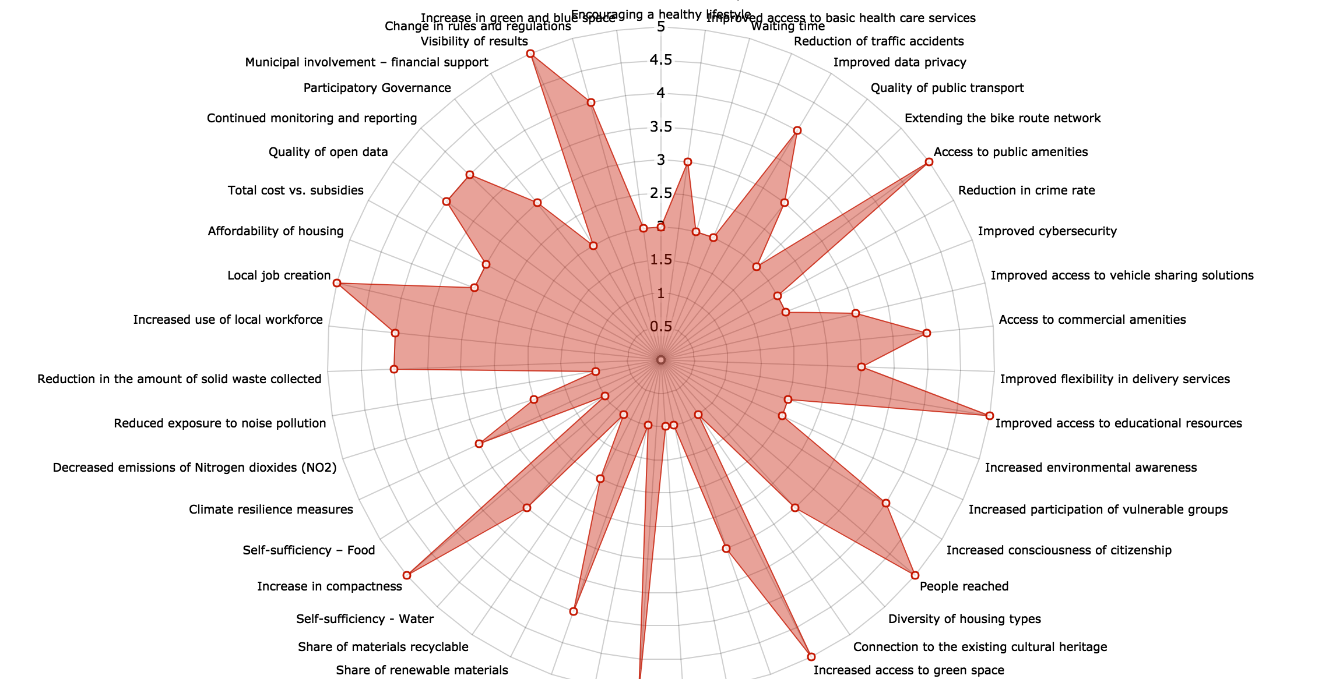
Notes:
This is desired output. From the KPI tool attached to CITYKeys. Let’s put aside the question of what you do with this output. It’s nice to have when we can get it…

Slide 7
Problems with the one-by-one approach
It’s expensive.
It’s subjective.
It’s ad hoc.
Is it worth it?
There’s just not enough data.*
* data that you want vs data that you have
Notes:
It’s basically a standard.

Slide 8
Towards a science of measuring systems
Cities are cyber-physical systems
Cities are systems of systems
These models are mathematical descriptions. They do not measure anything, per se.
Other mathematical descriptions:
Network approaches
Economic models
Game theory

Slide 9
Problems with the systems approach
People end up building toy models
See 90% of academic studies
Or they build highly specific, technical models… thus not “systems”
Or they build giant, unwieldy models
175 indicators in CITYKeys, 212 in the Boston Indicators Project, etc.
More than 43 (!) indicator frameworks built for “smart and sustainable cities”
The point is: models are useful locally, but they’re hard to sustain on bigger systems
Notes:
It’s basically a standard.

Slide 10
Towards a science of measuring cities
Problem: the models fail to describe the world perfectly. (Duh)
Problem: the data doesn’t either.*
* cities are complex: there isn’t enough raw data to describe all the interactions
Notes:
*Buzzword: “complex”.
If we had enough (good) data, we could build a giant correlation table between every indicator that we could imagine. Of course we don’t: that’s why we use models to infer these correlations (and other relations).

Slide 11
The hypothesis
Instead of constructing indicator frameworks expensively and internally, meaning indicator-by-indicator, we can specify them abstractly and externally, by means of their causal and statistical relationships to other, already-extant sets of indicators. Our approach is especially suited to situations where heterogeneous data is distributed across many projects and many localities.
Step 1: give a mathematical semantics for indicator frameworks.
Step 2: test whether indicator frameworks can be upgraded to synthesize “models over data”.

Slide 12
Data informs models, while models constrain data.

Slide 13
How do we construct operational indicator frameworks?
Expert input, Likert scales, but also…
We can refine old indicators by “cleaning” the data.
We can combine two indicators A, B into a new indicator by “joining them”, i.e. forming A x B.
We can compute or infer correlations between indicators, then describe proxies.
Notes:
Its already problematic, however, since “pairs” of indicators are no longer numeric!

Slide 14
Joined data
Data
Data
Joined data or “tensored” data

Slide 15
GAP
How do we join this data?

Slide 16
Model
Data
Model construction

Slide 17
“Solution”
Model
Data
Model application
“Problem”

Slide 18
Model
Data
Data
Model validation

Slide 19
Model
Data
Data
“Integrating under a model”
Notes:
Suppose you’re missing data, or the data is poorly versioned.

Slide 20
Model
Model
Data
Data simulation & integration

Slide 21
Model
Model
Data
The general case?

Slide 22
Abstract indicator frameworks
An abstract indicator framework is composed of:
A R-valued matrix whose columns represent indicators and rows represent data
An inner product operation between indicators, understood as their sample correlation
The set of all abstract indicator frameworks forms something called a category

Slide 23
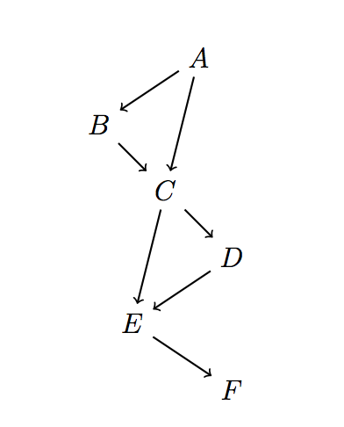
A simple model: causal diagrams
Causal diagrams are directed acyclic graphs, e.g.
Each causal diagram can be used to construct a monoidal category, called a causal theory [Fong ‘13].
Each graph, essentially, defines a procedure for computing testing a causal relationship over a set of correlations.

Slide 24
Activity: build your own diagram!

Slide 25

Example: Dynamics of the Transit System in Nashville, TN
Abhishek Dubey

Slide 26
Date | Weekday (Mon=0) | Segment | Direction | Route | Actual Travel (Seconds) | Scheduled Travel (Seconds) | Actual Arrivel Time (24hr) | Trip_ID | Driver_ID | Jam Factor (0~10) | Actual Traffic Speed (mph) | Free Flow Speed Limit (mph)
20161011 | 1 | MCC5_11 - HFOGG | FROM DOWNTOWN | 1 | 826.99998 | 360 | 15:35:39 | 126346 | 1683 | 3.487592973 | 13.24569763 | 19.82003285
20161011 | 1 | HFOGG - MTWD | FROM DOWNTOWN | 1 | 580.99998 | 600 | 15:48:05 | 126346 | 1683 | 3.937953674 | 11.96260066 | 18.78503114
20161011 | 1 | MTWD - 100O | FROM DOWNTOWN | 1 | 805.99998 | 660 | 16:01:31 | 126346 | 1683 | 2.793803409 | 17.05275554 | 23.36003872
20161011 | 1 | MCC5_11 - HFOGG | FROM DOWNTOWN | 1 | 802.99998 | 420 | 16:38:47 | 126347 | 1683 | 5.28474093 | 10.79350626 | 19.82003285
20161011 | 1 | HFOGG - MTWD | FROM DOWNTOWN | 1 | 648 | 600 | 16:49:35 | 126347 | 1683 | 4.822438899 | 10.89503857 | 18.78503114
20161011 | 1 | MTWD - 100O | FROM DOWNTOWN | 1 | 507.99996 | 600 | 16:58:03 | 126347 | 1683 | 0.024484444 | 26.24559907 | 23.36003872
20161011 | 1 | MCC5_11 - HFOGG | FROM DOWNTOWN | 1 | 900.99996 | 420 | 17:37:25 | 126348 | 1683 | 4.263709706 | 12.1785496 | 19.82003285
20161011 | 1 | HFOGG - MTWD | FROM DOWNTOWN | 1 | 609.99996 | 540 | 17:47:35 | 126348 | 1683 | 4.862932428 | 10.63845745 | 18.78503114

Slide 27
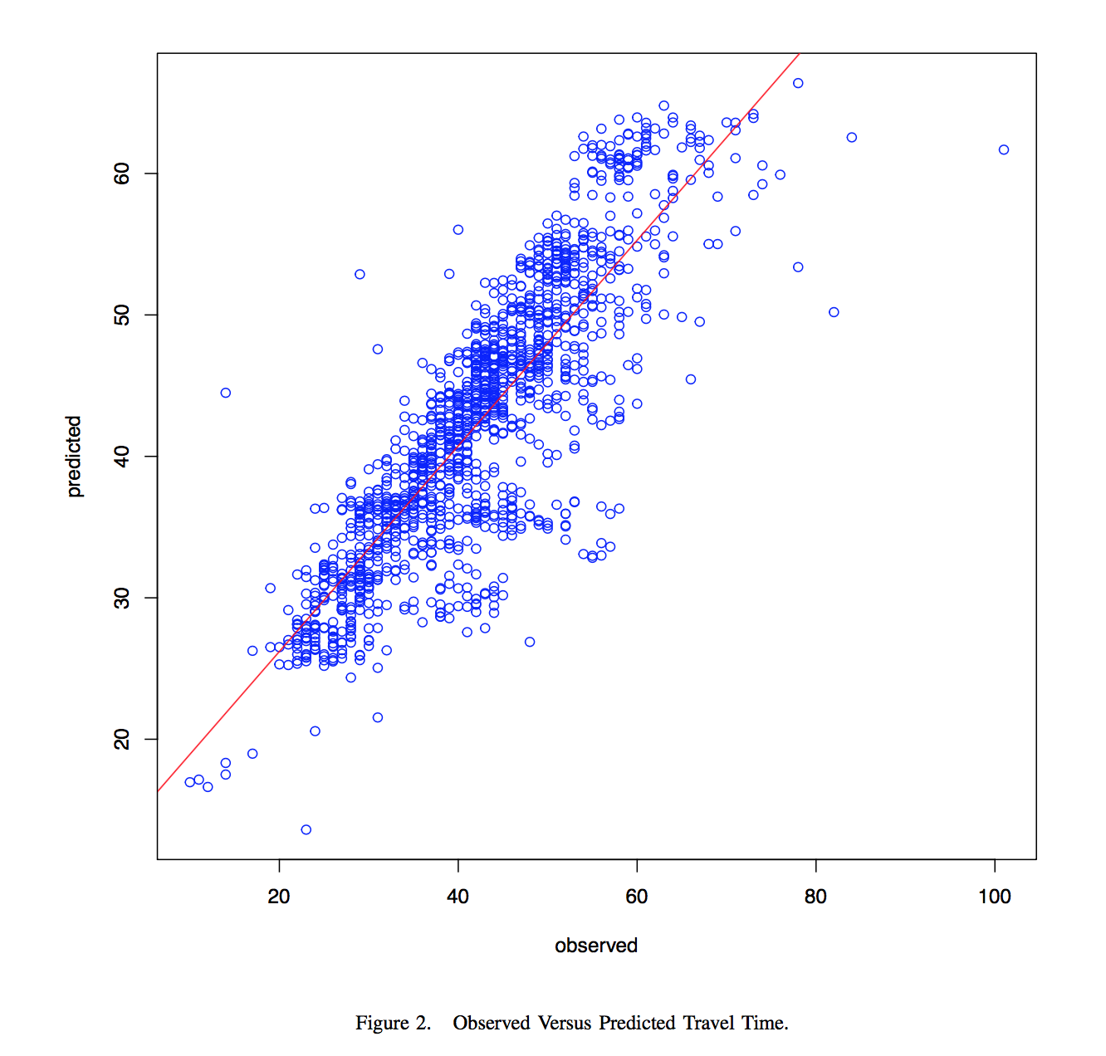

Slide 28
Toolbox
Scheduled
Travel Time
Predicted
Travel Time
Actual Travel Time (Bus)
Weather
Actual Traffic Speed

Slide 29
Toolbox
Predicted
Travel Time
Scheduled
Travel Time
Actual Travel Time (Bus)
Weather
Actual Traffic Speed

Slide 30
Toolbox
Predicted
Travel Time
Scheduled
Travel Time
Actual Travel Time (Bus)
Weather
Actual Traffic Speed

Slide 31
Toolbox
Predicted
Travel Time
Scheduled
Travel Time
Actual Travel Time (Bus)
Weather
Actual Traffic Speed

Slide 32
Toolbox
Predicted
Travel Time
Scheduled
Travel Time
Actual Travel Time (Bus)
Weather
Actual Traffic Speed

Slide 33
Toolbox
Predicted
Travel Time
Scheduled
Travel Time
Actual Travel Time (Bus)
Weather
Actual Traffic Speed

Slide 34
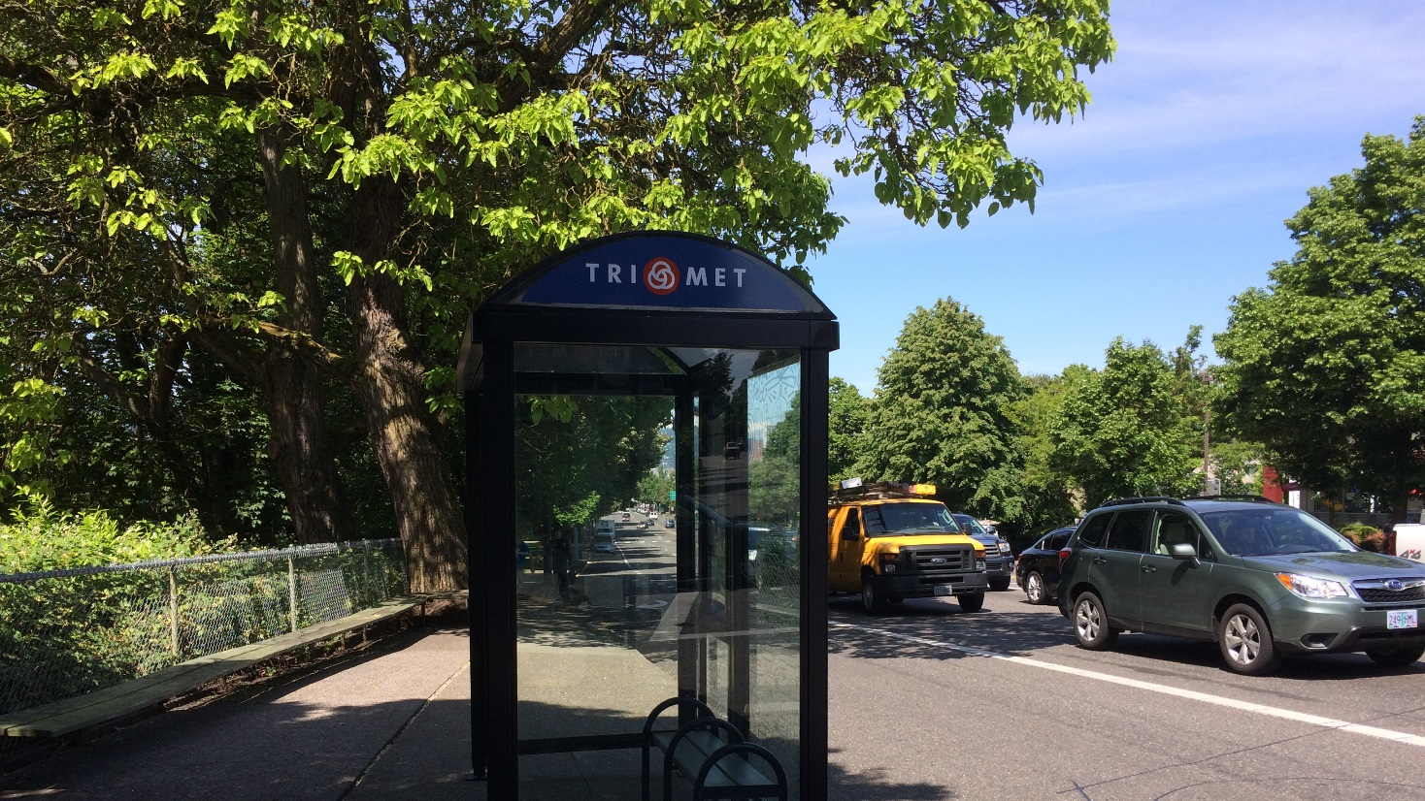
Understanding the Roadside Environment through Integrating Air Quality & Traffic-Related Data
Christine Kendrick

Slide 35
Findings
Season | Time Period | Coefficient NO per 100 vehicles per 15 mins | Standard Error of Coefficient NO per 100 vehicles per 15 mins | Adjusted r² | Coefficient NO₂ per 100 vehicles per 15 mins | Standard Error of Coefficient NO₂ per 100 vehicle per 15 mins | Adjusted r²
Fall | Morning | 6.3 ** (7.9)** | 1.4 (0.4) | 0.1 (0.16) | 1.2** (1.6)** | 2.3 (0.1) | 0.14 (0.24)
Winter | Morning | 9.4** (11.2)** | 1.4 (0.7) | 0.14 (0.24) | 1.5** (1.9)** | 0.4 (0.2) | 0.17 (0.26)
Spring | Morning | 6.3** (6.7)** | 0.8 (0.3) | 0.41 (0.43) | 2.5** (2.3)** | 0.3 (0.2) | 0.27 (0.28)
Summer | Morning | 4.6** (4.4)** | (0.4) (0.2) | (0.45) (0.37) | 1.3** (1.6)** | 0.3 (0.1) | 0.25 (0.23)
Fall | Evening | -1.3 (-1.6) | 2.5 (1.1) | <0.001 (0.005) | 1.2* (0.9) | 0.6 (0.2) | 0.05 (0.03)
Winter | Evening | -0.04 (0.09) | 2.6 (1.3) | 0.002 (0.001) | -0.4 (-0.08) | 0.8 (0.4) | 0.05 (0.03)
Spring | Evening | 2.1 (2.2)** | 1.1 (0.5) | 0.03 (0.04) | 0.9 (0.9)** | (0.8) (0.3) | 0.007 (0.02)
Summer | Evening | 2.1* (2.9)** | 0.8 (0.3) | 0.02 (0.07) | 1.6* (1.9)** | 0.7 (0.2) | 0.03 (0.05)

Slide 36
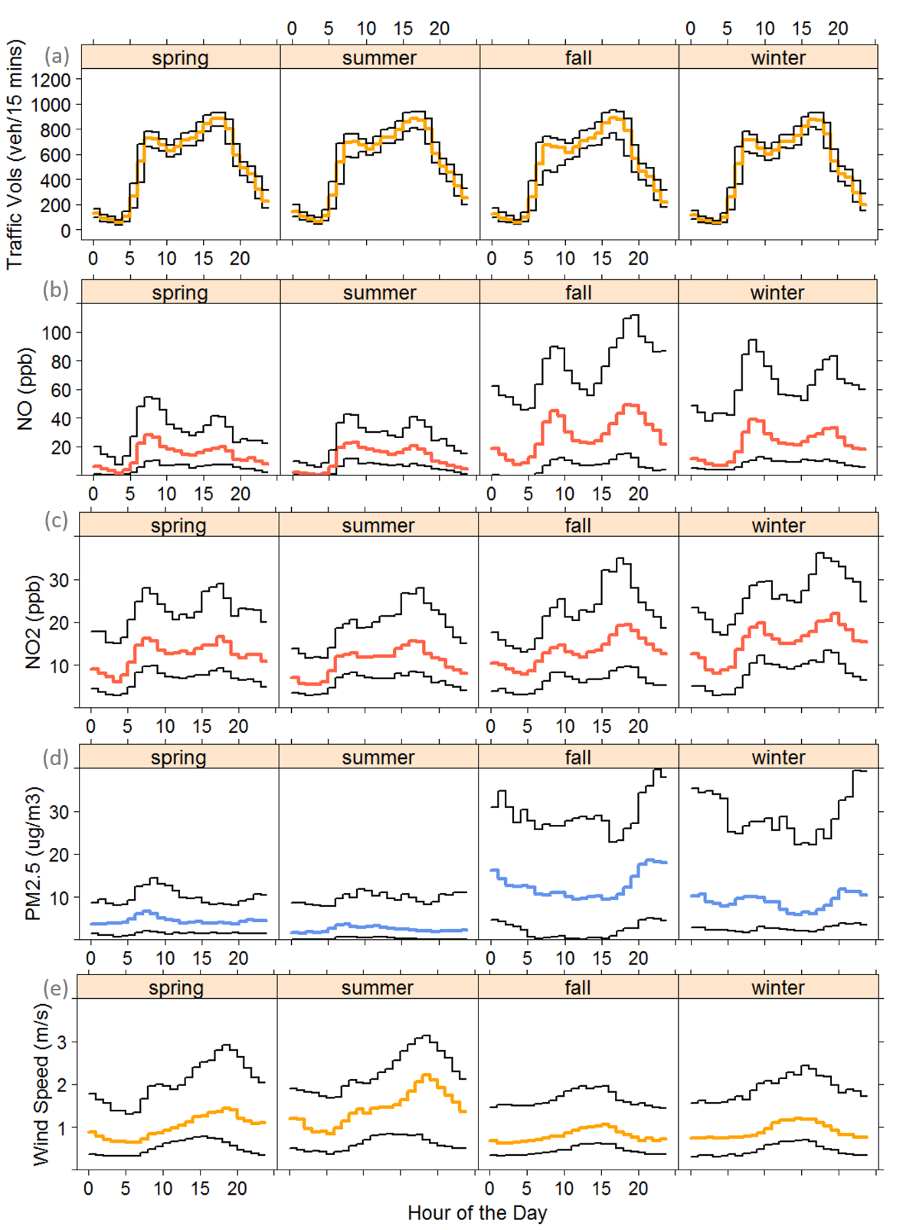
Seasonal Dirunal Patterns

Slide 37
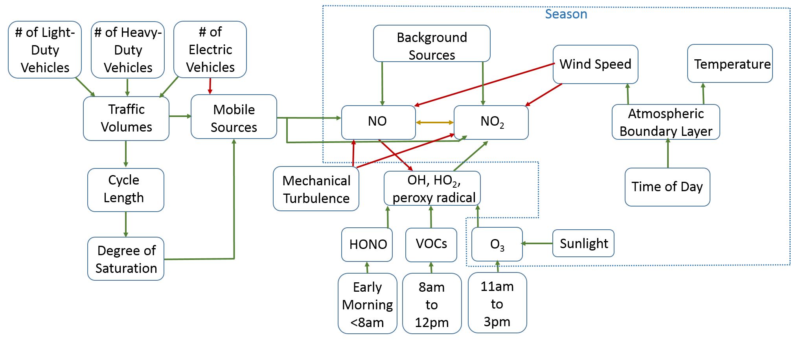
Notes:
Form causal diagram

Slide 38
Activity: build your own diagram!
Step 1: pick one of the subject areas
Step 2: write down, on yellow sticky notes, all the data you think would be relevant. Stick them on the paper
Step 3: arrange them causally, from bottom (antecedents) to top (descendants)
Step 4: draw red arrows for the causal model; make sure to join the variables if you need to
Step 5: pick out a few correlations that you think you can feasibly verify
Step 6: once you have a causal diagram… wait for further instructions!

Slide 39
Help us do science!
Do you need help with selecting indicators?
Contribute to a stable of examples.
Get published.
Notes:
Will people be really good at building these models already, and can incorporate their city into this network?

Slide 40
Thank you.
https://indicator-frameworks.github.io
or joshua.tan@cs.ox.ac.uk

Slide 41
Run Activity
What are we trying to do by organizing this conference?
Recruit individuals, action clusters, and companies to participate in the working group.
Build an audience for future work related to indicator systems.
What is each workshop team (3-4 people) trying to accomplish?
Design an indicator framework and compare to other indicator frameworks
What is each workshop participant going to get out of the talk/activity?
Better understand how to measure and evaluate their project or action cluster
Preliminary work:
Build website beforehand, with online sign-up.
Pick 6-8 different subjects.
Hang sheets of flip chart paper for each subject. Use sticky notes for variables.
Build skeletal diagrams for each subject for them to start with.
During the activity:
15 minutes to create the diagram
15 minutes for questions, discussion, and presenting results
After:
Josh, Christine, Abhishek debrief

Slide 42
Basic Outline
Josh on “background” for 30 minutes.
Christine: make sure to run our own example first.
Activity for 30 minutes? Basically, do the on-boarding process. Get them to write down a diagram of the indicators that they can think of. Then have them trade diagrams.
“Call for volunteers”, set-up a working group.
Framing examples from South Bend, walking them through that. There’s a larger research question of how the methodology works, but if it’s inherently helpful to follow Christine’s example, visualizing how different things connect, and that would be interesting to connect.
I will run the activity first on some graduate students at Oxford.
If we have people who may be interested in modeling indicator systems, areas of interest. “Round-table in urban instrumentation. As you’re forced to draw complex systems in, you get a better sense of the types of problems that people are interested in solving. The kinds of data that people are interested in using. Just inventorying that would give us some interesting insights.”
In cities, counties, there’s such a lack of time to think about a question that you might want to measure ahead of time, that going through this process (matching what you want to achieve versus what data you have), would be really useful. What questions can you actually ask and answer with that data. That’s really valuable, and it doesn’t happen a lot.
For Santi, looking at Christine’s diagram, it wasn’t like I was starting from scratch. Santi felt like he could build on Christine’s stuff. What were external variables, what were variables you could control.
“Corpse game for indicator frameworks.”
Instead of a worksheet--- what about an online activity?
Notes:
If you’re nerd, or if you have a nerd working for you, you might already be using this thing called a BAYESIAN NETWORK. So Abhishek over here is an expert in Bayesian networks…
What really usually happens is people make policy-oriented goals, not based on what data is actually available… data is hard to use in this way. Ask Santi.

Slide 43
Operational indicator frameworks
An indicator is a column of numeric data values. They are typically to used to measure inputs, immediate outcomes, and long-term impacts of city projects. We assume that all indicators are time-varying.
An operational indicator framework is just a list of indicators, sometimes organized hierarchically.
id,id_wasp,id_secret,frame_type,frame_number,sensor,value,timestamp,raw,parser_type 44637,city1,408414489,128,132,noise,50,"2016-08-10 06:00:29",noraw,0 44679,city1,408414489,128,138,noise,52,"2016-08-10 06:02:24",noraw,0 44742,city1,408414489,128,143,noise,51,"2016-08-10 06:04:00",noraw,0 44777,city1,408414489,128,149,noise,55,"2016-08-10 06:05:55",noraw,0 44819,city1,408414489,128,152,noise,60,"2016-08-10 06:06:53",noraw,0 44875,city1,408414489,128,160,noise,62,"2016-08-10 06:09:27",noraw,0
Notes:
This is definitely a limited view of operational indicator frameworks… more research pending.

Slide 44
Abstract indicator frameworks, v1
An abstract indicator framework is composed of:
A R-valued matrix whose columns represent indicators and rows represent data
An inner product operation between indicators, understood as their sample correlation
The set of all abstract indicator frameworks forms something called a category

Slide 45
Mathematical background: category theory
Category theory was originally invented in the 1960s to integrate different aspects of mathematics, especially topology and algebra. It is now being tested by a variety of different agencies, like NIST and DARPA, as a language for modeling and integrating large, heterogeneous systems, e.g. Nextgen or CASCADE.
A category C is a collection of objects, called the objects of C, along with a collection of maps, called the morphisms of C, satisfying certain properties.
A functor F : C -> D between two categories is a map taking objects of C to objects of D, and morphisms of C to morphisms of D in a compatible way.

Slide 46
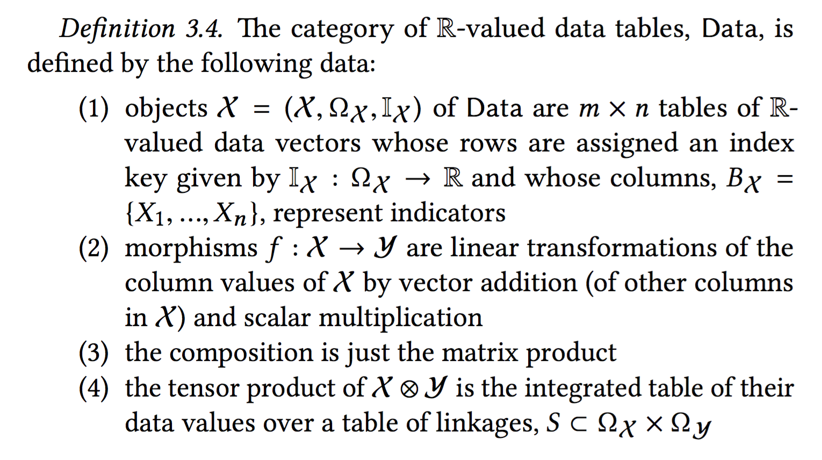

Slide 47
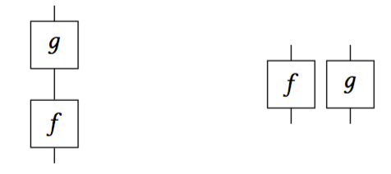
Mathematical background: monoidal categories
A category with a tensor operation ⊗ : C × C -> C, satisfying certain properties, is called a monoidal category.
Essentially the tensor allows you to compare morphisms in parallel, while composition allows you to compare morphisms in series.
Notes:
Bonus: monoidal categories have a convenient graphical representation: they essentially encode process diagrams.
Upshot: this is part of a generic strategy for capturing operational indicator frameworks: formalize part of the structure.

Slide 48
Abstract indicator frameworks, v2
We want to abstract from the data management aspect. It’s the choice of the indicators that is important, not the individual rows of data underneath.
Many of operations on indicators are purely statistical, e.g. correlation, so we would like to define them in a general context.
We especially want to emphasize correlation, because it emphasizes relations between indicators rather than the indicators themselves.
We want to set the stage for linking models to data.
This motivates the following definition:
Notes:
In particular: define them as random variables.

Slide 49
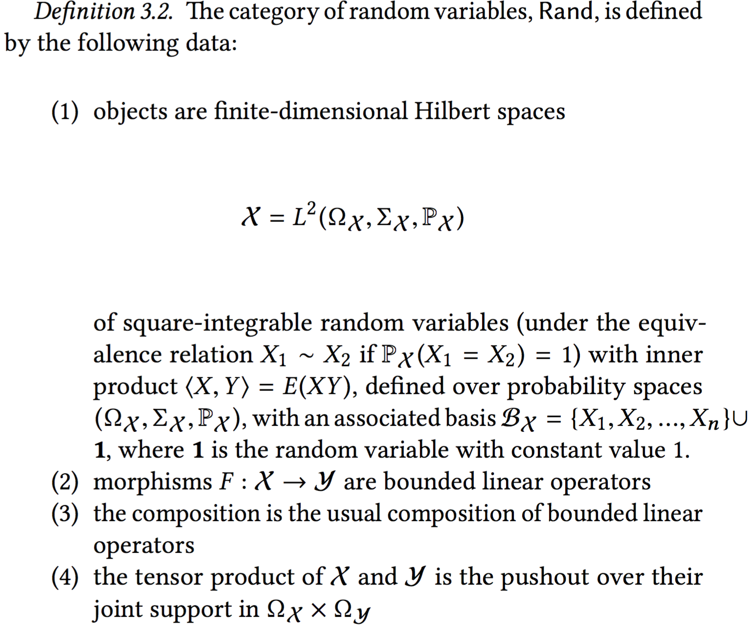
Notes:
You can ignore the details for now: in essence, this is a structure that encapsulates the typical things we want to do with data. It includes a language of constraints.
The strategy is to pass things into this category.

Slide 50
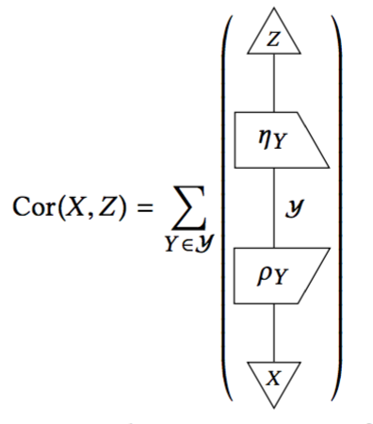
Defining new indicator frameworks in Rand
Given two indicator frameworks X and Z in Rand, one can write “formulas” in Rand that describe new indicator frameworks, exactly analogous to how one defines mediating (or confounding) variables in statistics. In the diagrammatic calculus, these look something like this:
Notes:
Recall: \rho_Y and \eta_Y represent computing the residuals.
The point: instead of constructing operational indicator frameworks expensively and internally, meaning indicator- by-indicator, we can specify them abstractly and externally, by means of their causal and statistical relationships to other, already- extant sets of indicators.

Slide 51
Abstract indicator frameworks, v3
The causal diagram serves as a primitive model of a given context.
The category Rand of random variables serves as a (still primitive) semantics of how we use data.
The idea: define constraints in Rand, and thus indicator frameworks, by mapping the causal theory into Rand; this creates a model of the causal theory in Rand., i.e. an indicator framework based on the causal theory.
Notes:
We can construct a functor from a causal theory C to the category of random variables, Rand.

Slide 52
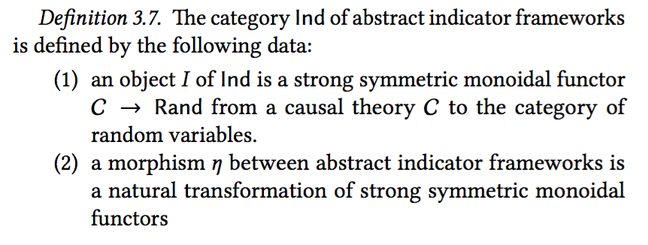

Slide 53
Future Work
More examples!
Constructions besides mediating frameworks
Improved semantics on Rand
True “hybrid indicator frameworks” for CPS models

Slide 54
Example: Shot Spot in South Bend
Courtesy of Santiago Garces, CIO of South Bend, Indiana
Target indicator: reduce crime
Target indicator: reduce gun crime and group-related activity
Target indicator: target interventions at specific group members
Means: Incorporate Shot Spot information with 911 dispatch calls. “Whenever, a shot incident is detected and a resident also calls 911 to inform of the incident, the dispatch is classified differently than when a signal is detected but not accompanied with a resident's call.”
Notes:
The point: putting together a set of indicators, and populating them, is not an easy task!

Slide 55
Example: Shot Spot in South Bend
Indicators Used
The total number of shootings involving a group member, compared to a 3 year rolling average;
the ratio of group member involved shootings, compared to the total number of criminal assault shootings;
Number of shooting incidents recorded both by Shot Spotter and residents
Number of direct interventions with group members, or close social relatives
Number of call-ins (large meetings where notorious group members are presented with the opportunity to get involved with social services, or communicated the enforcement action alternative)
Number of enforcement actions, interventions directed at executing warrants and investigations against the most violent group
Ratio of shots where a resident called as a shot is detected by Shot Spotter (proxy for community trust and collaboration with the Police Department)
Percentage/ s-value of number of complaints relative to calls for service

Slide 56
Example: Shot Spot in South Bend
Things we need to model:
Frameworks that draw on indicators from a number of different sources: ISO 37120 for overview, FBI uniform crime reporting program, 911 CAD system, Shot Spotter, internal databases for group activity and “interventions”
Comparisons of indicators as indicators, e.g. the total # of shootings compared to a 3 year rolling average
Logical operations on indicators, e.g. # of shootings recorded by Shot Spotter AND local residents, # of direct interventions with group members OR close relatives
Relationship between indicator and `sub-indicators’
Properties of indicators, like how difficult it is to supply that indicator

Slide 57
Example: Nextgen
Courtesy of John Baez and Metron
Nextgen: “Next Generation Air Transportation System”
From DARPA: “The DoD and urban infrastructure capabilities are increasingly based on the integration and coordination of heterogeneous systems using System-of-Systems (SoS) architectures. However, it is difficult to model and currently impossible to systematically design such complex systems using state-of-the-art tools, leading to inferior performance, unexpected problems, and weak resilience. This inadequacy in design capability results from the complexity of interactions between system structures and behaviors across multiple time and length scales that cannot be adequately modeled using conventional approaches.”

Slide 58
Non-temporal indicators
E.g., location-varying indicators like energy use per building:
Property Name | Reported | Property Type | Address | ZIP | Gross Area (sq ft) | Site EUI (kBTU/sf)
MEEI -Longwood | Yes | Ambulatory Surgical Center | 800 Huntington Ave | 02115 | 76,300 | 173.1
Prime Motor Group | Yes | Automobile Dealership | 1525-1607 VFW Parkway | 02132 | 150,000 | 28.7
New England Center for Homeless Veterans | Yes | Barracks | 17 Court St. | 02108 | 130,000 | 49.8

